Slide 1


Architecture Review Board – SPARK
December 2025

Slide 2
Current Situation
For teams receiving High email volume, which causes manual processing and facing risks missing high-priority communications.
Management lacks consolidated insights for situational awareness; technical staff lacks categorized, actionable queues to prioritize work.
Inconsistent and manual enforcement of emails content categorisation.

Slide 3
Current Situation
Time-consuming to handle high volumes of emails
Enhance the visibility on the workload
Lack of consolidated actions
Inadequate management of team mailboxes
Enhance the visibility on the workload

Slide 4
Objective
Implement an intelligent email management solution that provides a Batch handling and review for IT team mailboxes via orchestrator & automation for categorization, and summarization.(Only ‘Restricted’ or below emails will be processed)
Reduce manual categorisation and assign emails task to staffs.
Provide consolidated management insights through “Summarization”.
Ensure team categorisation result consistently (Only admin of team mailbox can edit the prompt).
Restricted email standards
(make sure all the restricted email hierarchy align)
- CMS (confidential mailing system)

Slide 5
Objective
01
02
03
VD-Native Application
Utility Services
No personal data stored
No data leaves the VDI environment
Runs locally within your own VDI
Batch Summarization, Categorization, and Configurator
Further functional integrations will be delivered.
No usernames or passwords stored
No emails content stored No

Slide 6
Scopes
Local utility running in your own VD
Email ingestion from CMMP via IMAP using Windows AD-authenticated service accounts for designated IT team shared mailboxes.
Security filtering to enforce HKMA data classification: only “Restricted” or below processed; fail-closed behavior for unknown/untagged/encrypted/confidential.
Management: daily digest with trends, volumes, and high-priority highlights, “Yesterday” backlog view.

Slide 7
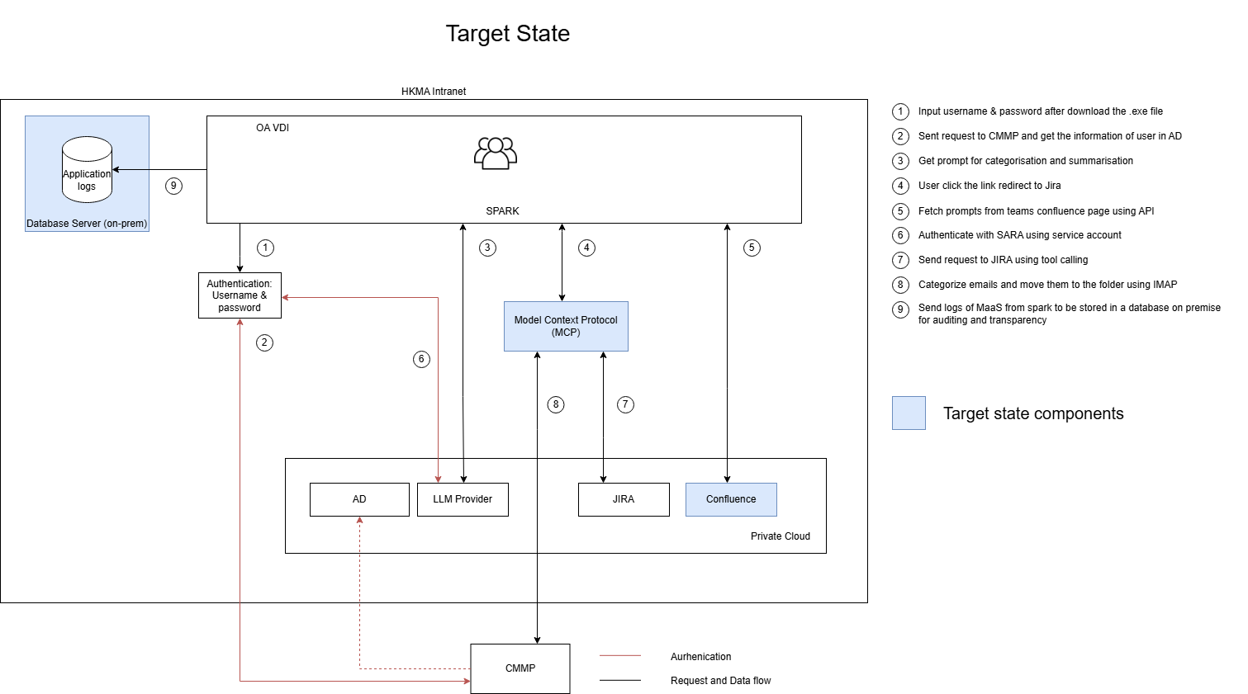
Logical Architecture
Way to authentication the OA account with team accounts
Amount of team mailbox
Defining user workflow? Customised workflow?
Template workflow suggested.
Missing tech-stack
Mention future state: connect to Dify and other applications (which application that may have to further discuss and seek for teams’ requirement
Question: do we require to have the common data store for teams?
For prompt alignment
Suggested: Sharepoint
Should have 2 MCP in the logical diagram (?

Slide 8
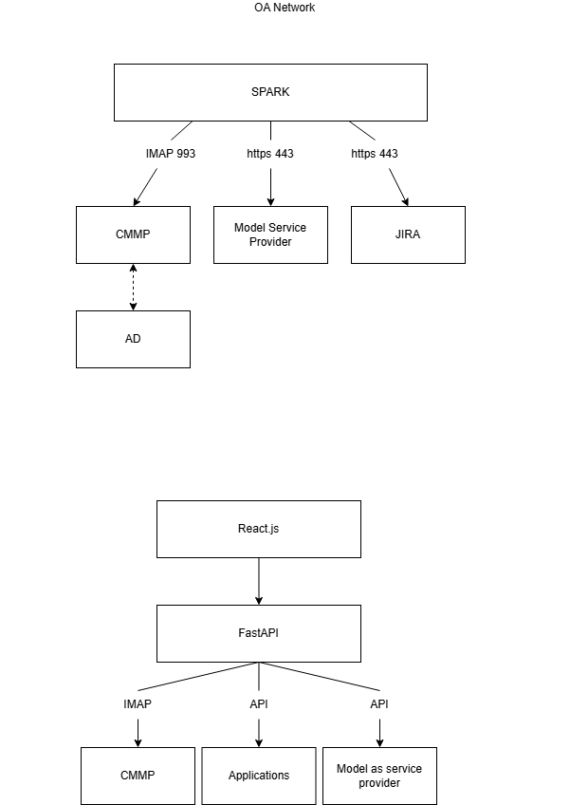
Logical Architecture
functional team mailbox will not receive CMS emails sent by CMS users only identify through email subject with the prefix added IMAP
Application log:
Technology
Frontend | Typescript
Backend | FastAPI (Python)
Framework | React.js

Slide 9
Non-functional features
Highlights:
Application is deployed and installed to end user VD via executable file(.exe)
User interface of application will be rendered by loading static HTML pages
End user authentication will be managed in the AD
Prompts will be fetched from the confluence page for each team
LLM Provider (MaaS / SARA) will be used
Remarks:
Username & password Auth will use for UAT environment.
Target stage : Function will run automatically during non-peak hour (Not in UAT)
Question: why not directly linked to SARA
MaaS has no queue management
ANS: depends on the usage of the users and whether the queue management is required
Remarks things that cannot be achieved
-

Slide 10
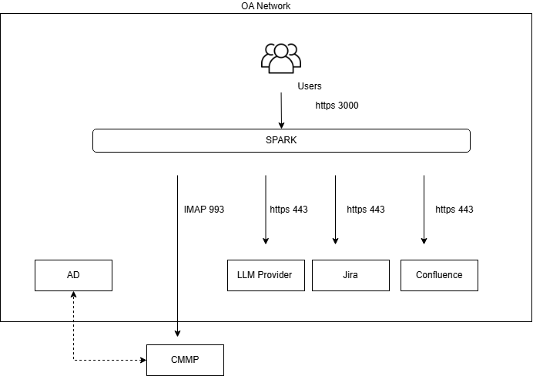
Physical Architecture
Highlight
All components are connected via HTTPS
SPARK use the username and password connect to AD, uses TGT to get AD group which contains authorization information
AD information is use to authenticate to CMMP
Product position – utility
Question: authentication model of Jira and Sharepoint
Remove the prompt storage
Clarity on the application log

Slide 11
Network Architecture
Model as service provider | Maas Depend on the usage of users and the queue management may switch to using SARA
JIRA | Authentication: OAuth
IMAP/AD | Limitation: Access functional team mailboxes with associate Window AD only

Slide 12
Difference between SPARK & Outlook & NOVA
Team mailbox | SPARK | Outlook | NOVA
Purpose | Insights and action layer that batches LLM summarisation and consistent team-wide categorisation, routes users for actions. | Action layer. It is the authoritative email client where users read in detail, reply/forward, move/flag/categorise, schedule meetings, and keep the conversation history. | Insight and action layer,
Timeslot | Day before | All Time | All Time
Allowed email categories | ‘Restricted’ or below | All emails | ‘Restricted’ or below
Function | Batch summarisation & categorisation Reply draft (later sprint) | Reply, Schedule meeting, forward etc | Single translate, draft reply, summarisation
Read | Team mails(Restricted or below) | All emails | Copy & Paste emails from user
NOVA – MS integration focused
Spark – local VD utility focused
Why we need for the application log > AI governance (?
Where we should store the application log and what to store
Discuss with ITS on the utility DPO requirement
Q : When should I use each one?
A : Outlook: Search for previous emails & send new email on behalf of team mail account
Spark: Get action insight and emails overview from the day before
Align with Dify Team – if they turns out will open up for the API key, then our target state should be integrated with Dify
With all the hardening stuff will be handled by Dify
Question: overlapping of Dify(?
Overlapping with UIPath?

Slide 13
Data Flow
Key Assumption
Disclaimer for Prompt input
Prompt history store in local SQLite database (10 most recent prompts)
Fetch and store the prompts in Confluence for team mailbox admin
SPARK supports data summarization and categorisation as RESTRICTED or below
Summary
Only application logs and prompt template will be recorded
Emails classified as CONFIDENTIAL or above will be blocked by SPARK (Fetch the emails by subject to identify the tag of email, e.g. confidential and encrypted pattern email not process in LLM)

Slide 14
Future Develop Feature

Slide 15
Security Design
Item | Description
Data at rest | N/A
Data in transit | HTTPS
MaaS authentication (Current stage) | API key
SARA authentication (Target stage) | Service account
Prompt fetch from Confluence (Target stage) | Connect to Confluence only for admin of team to include the prompts. Fetch prompts from confluence on a frequency of 6 hours. Prompt has to be restricted or below.
Authentication for CMMP | PLAIN, Pass the pw to local backend (in memory)
Jira Authentication & Authorisation | OAuth2, access read/write issue ONLY
MCP Authorisation (Target stage) | Authorise users to use MCP
Current State
Target State

Slide 16
Top 10 LLM threats
Item | Description | Mitigation
LLM01: Prompt Injection | A Prompt Injection Vulnerability occurs when user prompts alter the LLM’s behavior or output in unintended ways. | Pattern matching the prompt to detect prompt injections (target state)
LLM02: Sensitive Information Disclosure | Sensitive information can affect both the LLM and its application context. This includes personal identifiable information (PII), financial details, health records, confidential business data, security credentials, and legal documents. | Disclaimer to user to not enter PII. Pattern matching to detect PII an remove from the user prompt (target state).
LLM03: Supply Chain | LLM supply chains are susceptible to various vulnerabilities, which can affect the integrity of training data, models, and deployment platforms. | Rely on AI team for MaaS and EFIO Team for SARA
LLM04: Data and Model Poisoning | Data poisoning occurs when pre-training, fine-tuning, or embedding data is manipulated to introduce vulnerabilities, backdoors, or biases. | Rely on AI team for MaaS and EFIO Team for SARA
LLM05: Improper Output Handling | Improper Output Handling refers specifically to insufficient validation, sanitization, and handling of the outputs generated by large language models before they are passed downstream to other components and systems. | Encode model output back to users to mitigate undesired code execution by JavaScript or Markdown.
LLM06: Excessive Agency | An LLM-based system is often granted a degree of agency by its developer - the ability to call functions or interface with other systems via extensions (sometimes referred to as tools, skills or plugins by different vendors) to undertake actions in response to a prompt. | Current: Not applicable for this case Target: Will approve from user for reply and third-parties
LLM07: System Prompt Leakage | The system prompt leakage vulnerability in LLMs refers to the risk that the system prompts or instructions used to steer the behavior of the model can also contain sensitive information that was not intended to be discovered. | Leverage the existing prompt guardrail on SARA and input/output validation.
LLM08: Vector and Embedding Weaknesses | Vectors and embeddings vulnerabilities present significant security risks in systems utilizing Retrieval Augmented Generation (RAG) with Large Language Models (LLMs). | Not applicable in this case.
LLM09: Misinformation | Misinformation from LLMs poses a core vulnerability for applications relying on these models. | Human Oversight and user education.
LLM10: Unbounded Consumption | Unbounded Consumption refers to the process where a Large Language Model (LLM) generates outputs based on input queries or prompts. | Proper rate limit control on MaaS.

